Slide 1
Tom Purdom Marion IN
AN UNLIKELY FAITH

Slide 2
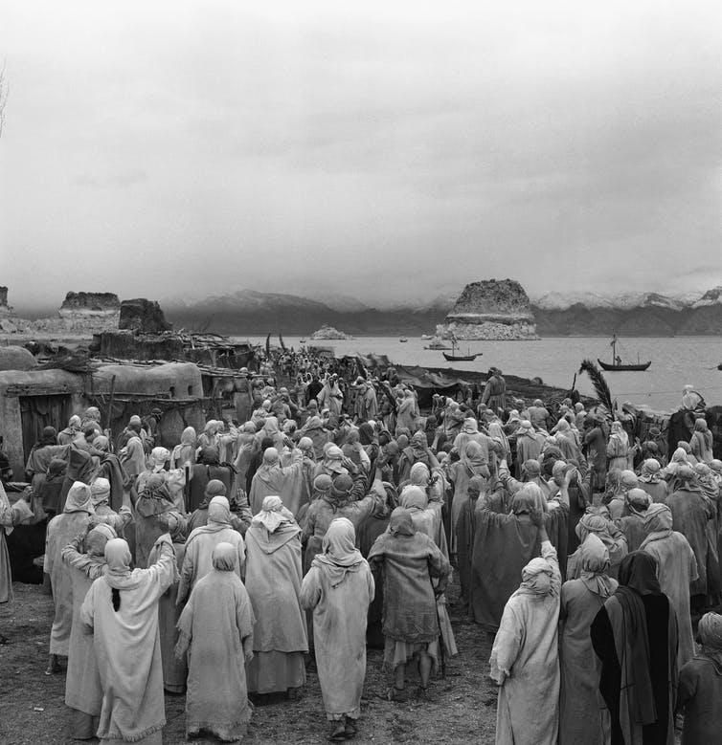
Mk 5:21 – Jesus crosses back to Capernaum – Met with multitude of people

Slide 3
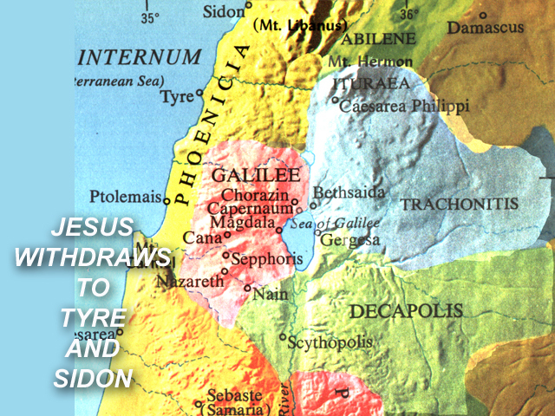

Slide 4
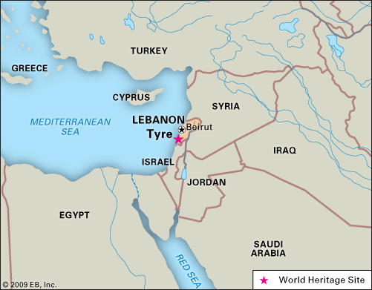

Slide 5
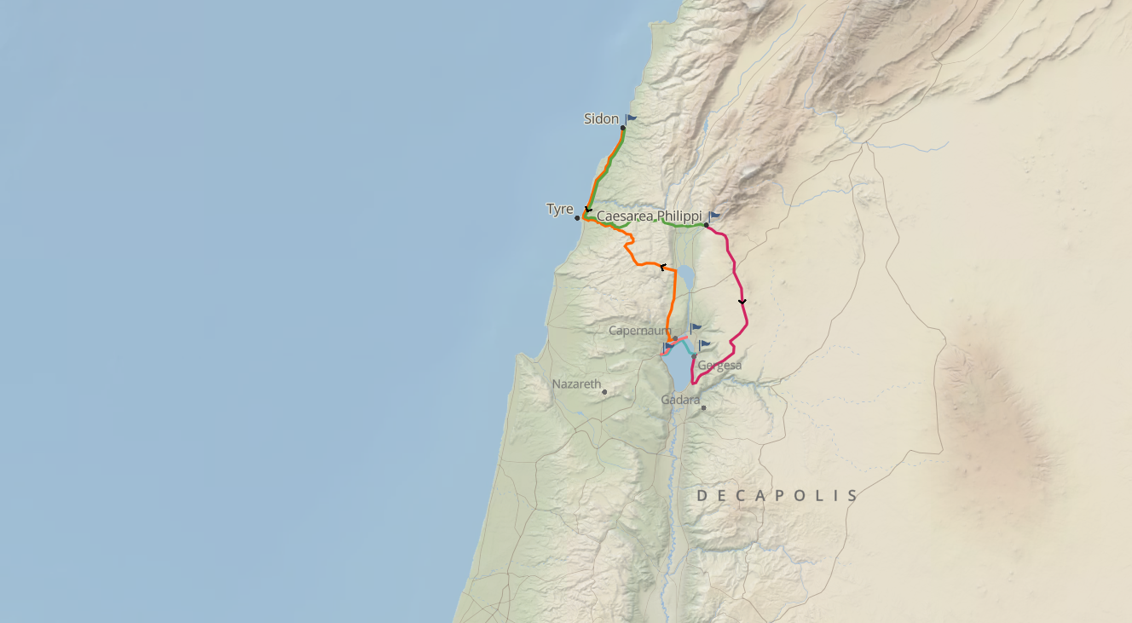

Slide 6
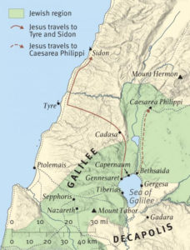
Distance = 35 Miles Capernaum to Tyre 60 miles Capernaum to Sidon

Slide 7
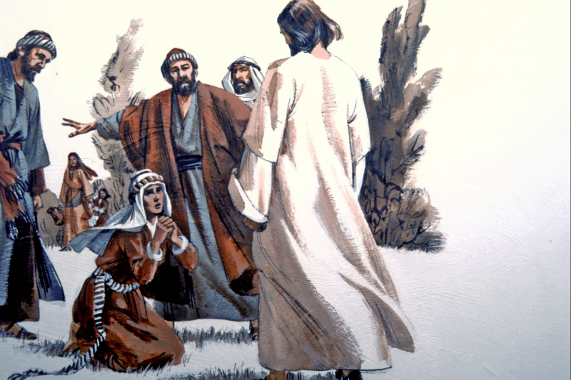
Gentile
Woman
Syrophonecian
Canaanite
AN UNLIKELY FAITH

Slide 8
An Unlikely Faith Matthew 15:21-8; Mark 7:24-30
Matthew Emphasizes
FAITH
Mark Emphasizes
A World For Christ

Slide 9
An Unlikely Faith Matthew 15:21-8; Mark 7:24-30
FAITH
HUMILITY
PERSISTENT

Slide 10
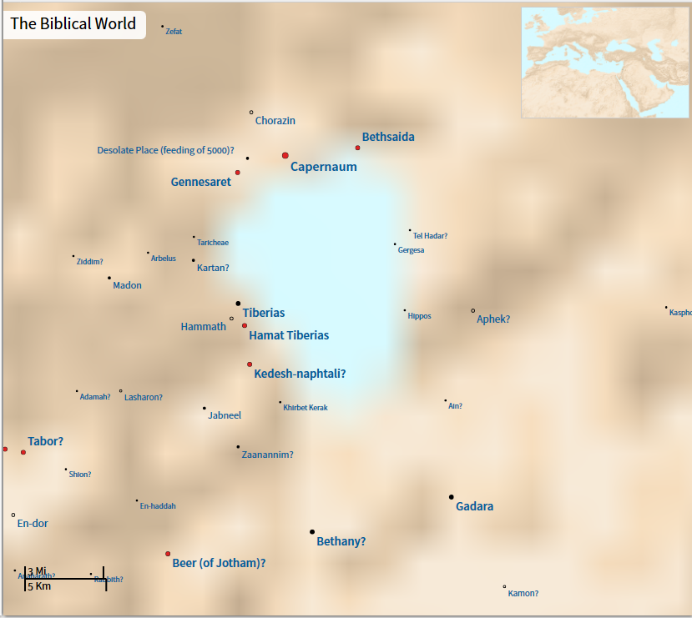
JESUS RAISING JAIRUS’ DAUGHTER FROM THE DEAD (Matt. 8:1, 5–15; Mark 3:20, 21; Luke 7:1–10.)
Sea of
Galilee

