Slide 2
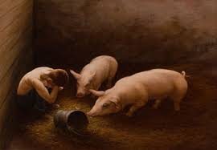
SEEKING THE PRODIGAL

Slide 3
SEEKING THE PRODIGAL
CONTINUE
CONSISTENT
CONNECT
CONFESS

