Slide 2
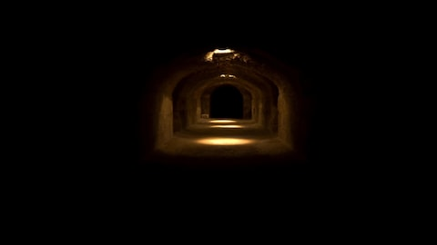
SINGING AT MIDNIGHT

Slide 3
SINGING AT MIDNIGHT
DON’T ISOLATE YOURSELF
DONT JUDGE THE VICTIM
DON’T JUDGE GOD

Slide 4
