Slide 2
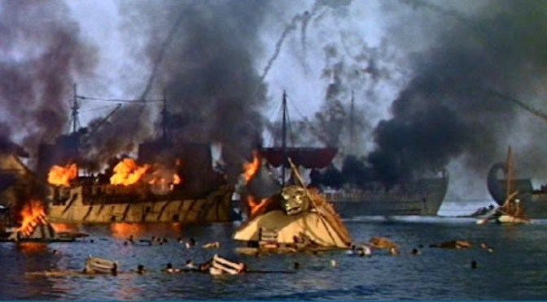

Slide 3
BURN THE SHIPS
Committed To:
His Word
His Work
His Worship

