Slide 2
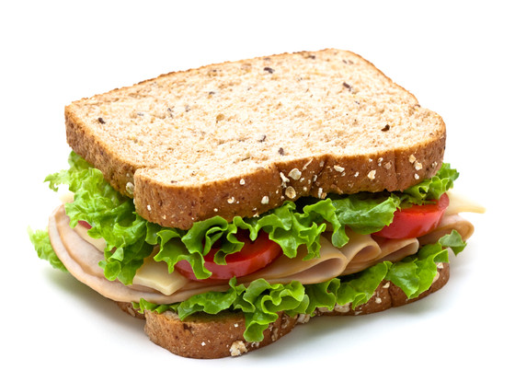

Slide 3
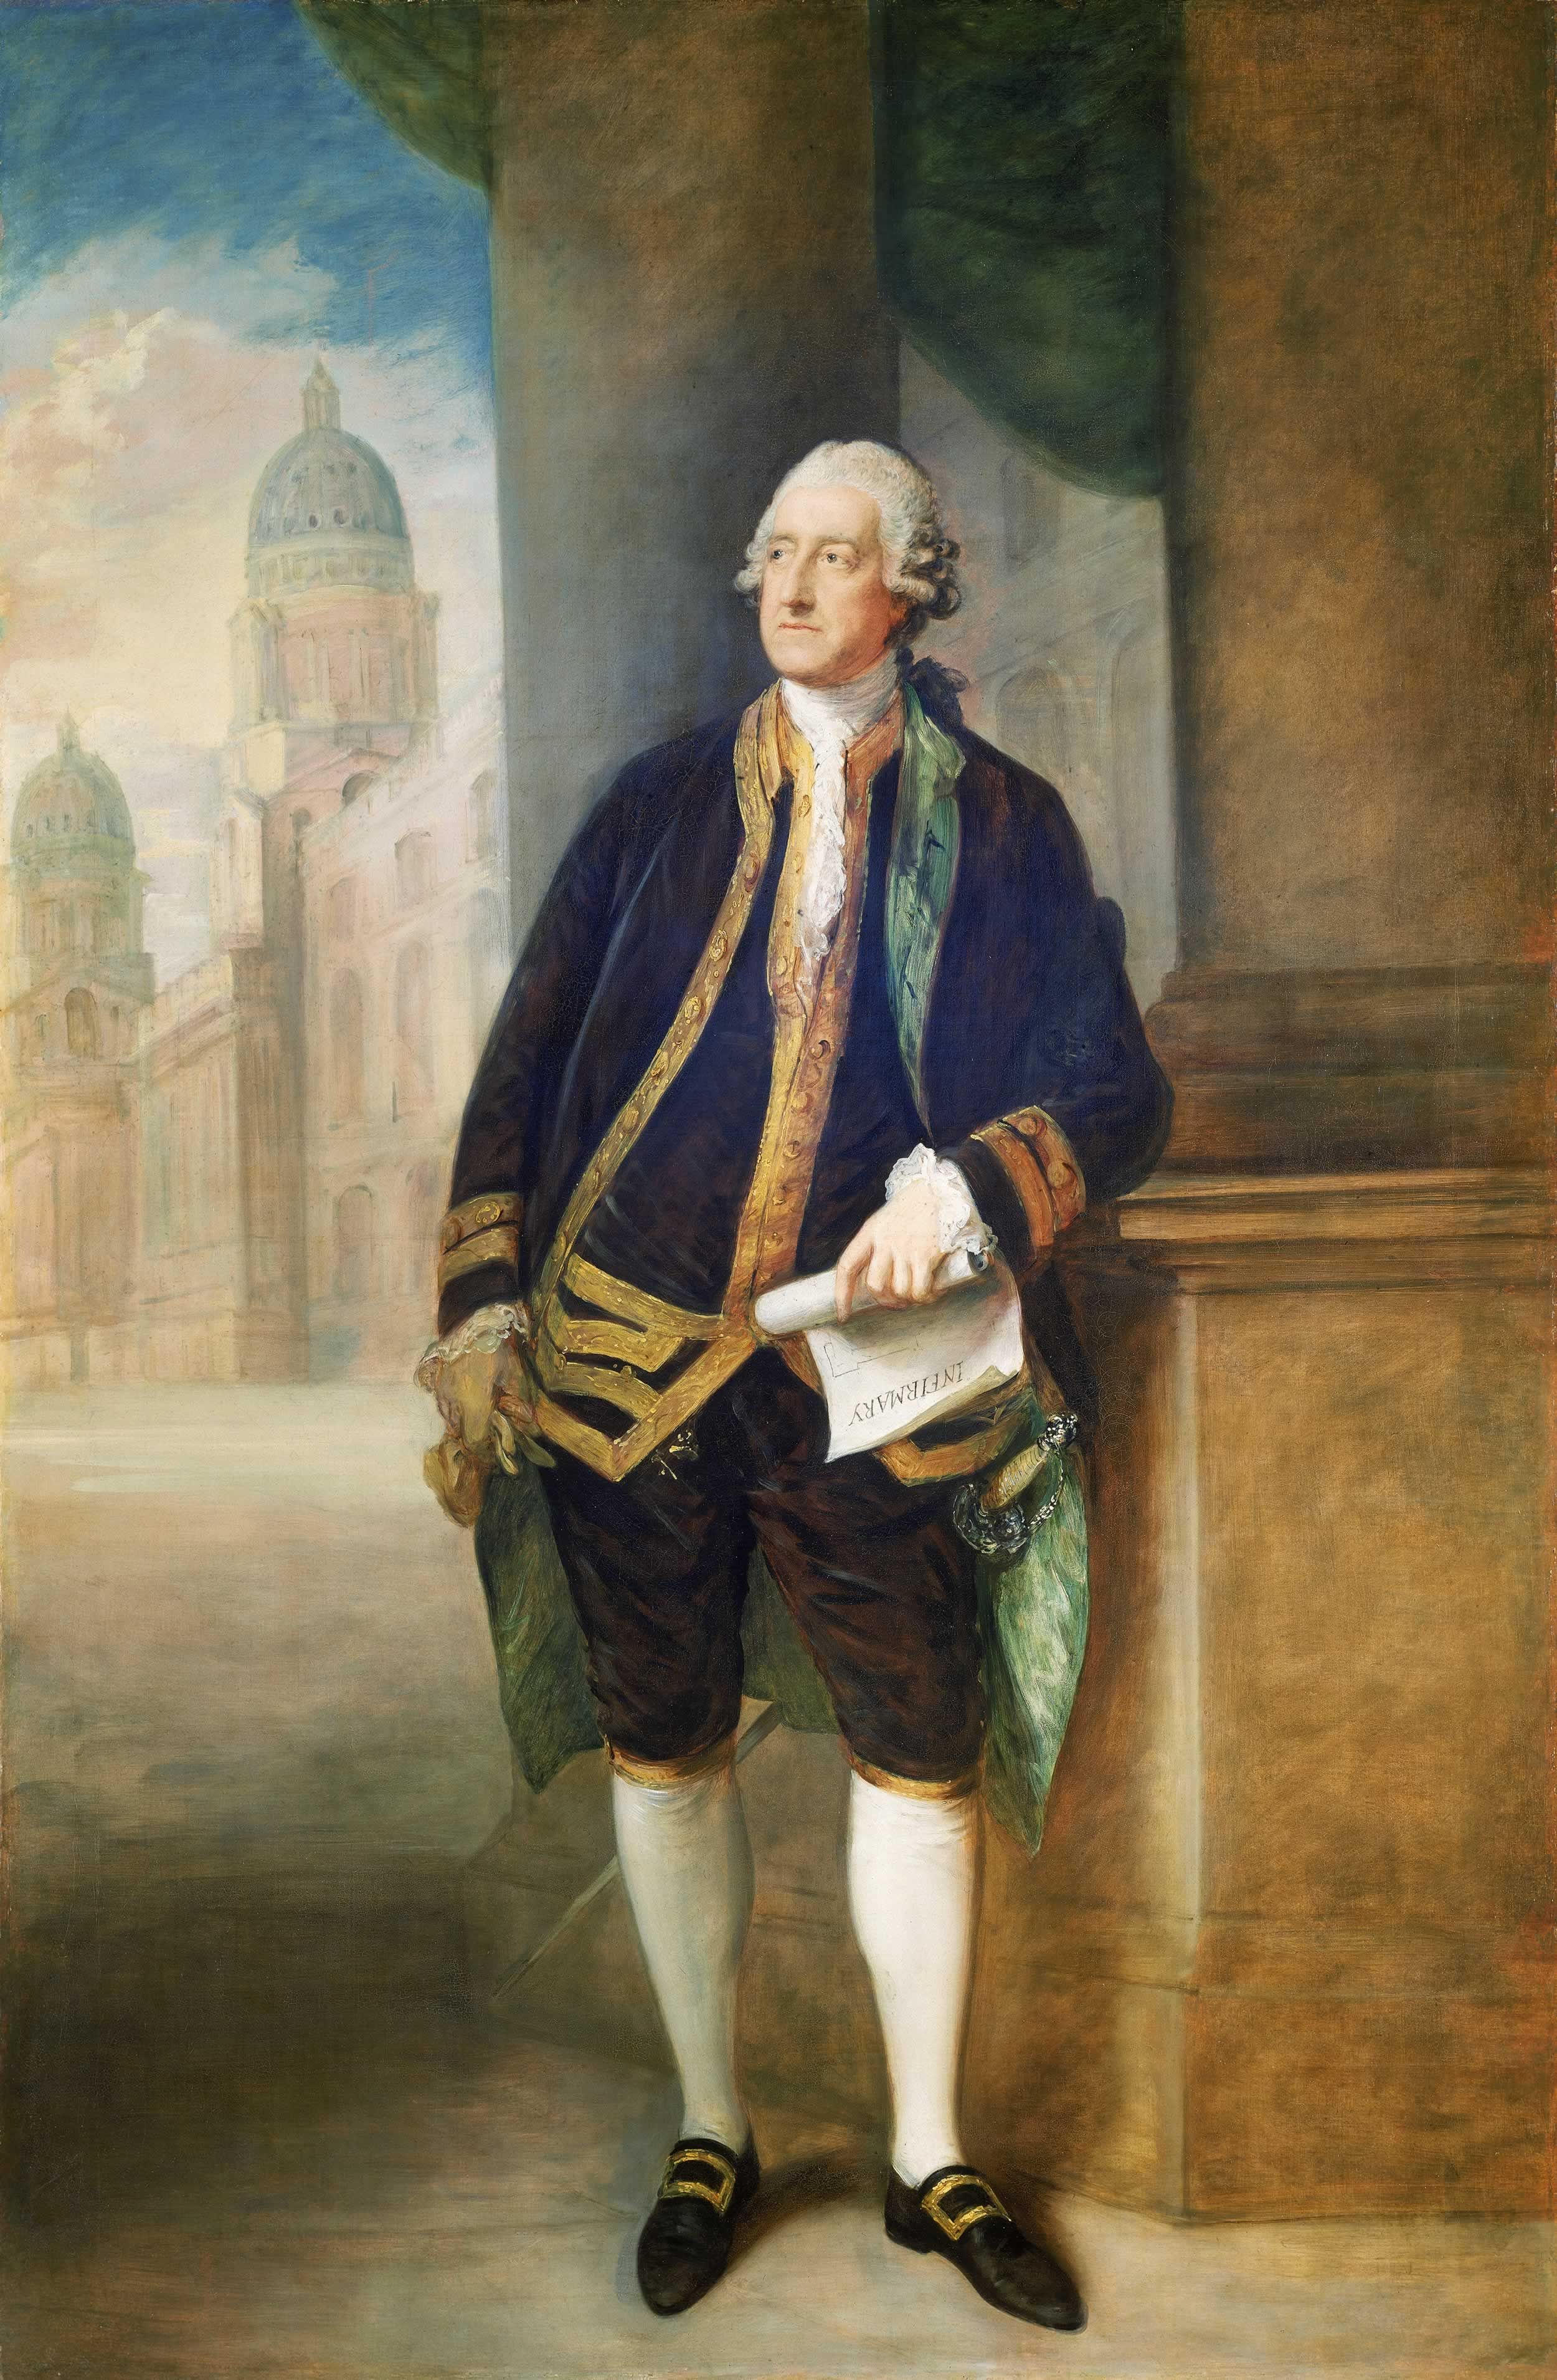

Slide 5
LUNATIC
Don’t believe Him
To protect Him
LIAR
Divides Satan
Defeats Satan
Defames the Spirit
LORD

