Slide 2
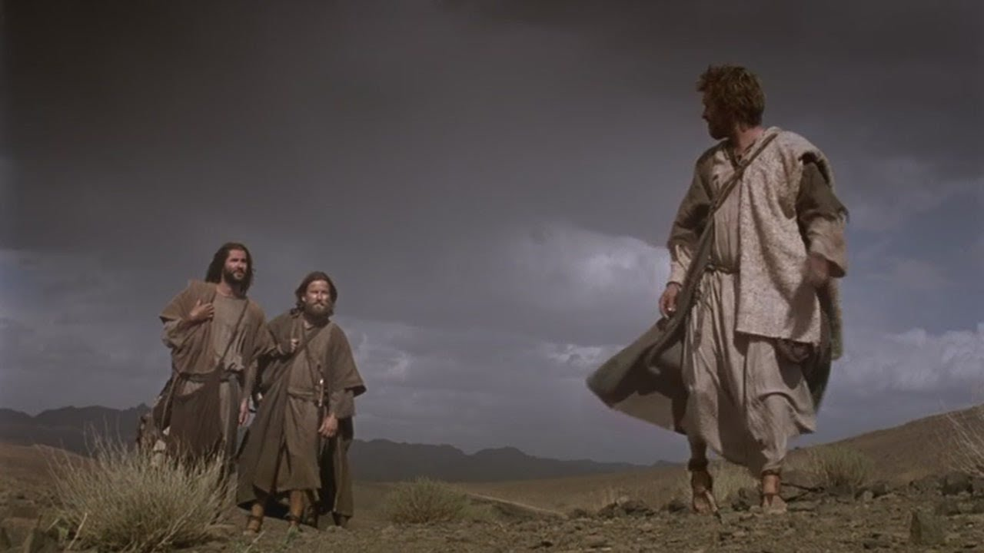
THE EULOGY OF JESUS

Slide 3
THE EFFECTS OF DESPAIR
DISASSOCIATE
DIGRESS
DOUBT

