Slide 2
DENIALISM
“A defense mechanism in which confrontation with a personal problem or with reality is avoided by denying the existence of the problem or reality”

Slide 3
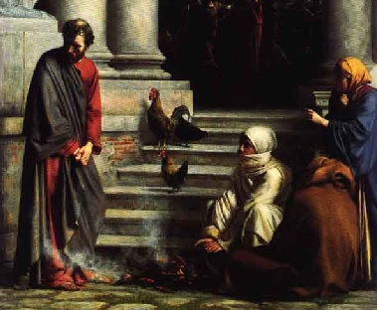

Slide 4
CHRIST KNEW
BEFORE IT HAPPENED
WHEN IT HAPPENED
AFTER IT HAPPENED
Words of Animosity
Words of Appreciation
Words of Affection

Slide 5
“And PETER”
Possible
Personal
Private

Slide 6
“And Peter”
We can all fall
If we deny Jesus, He will deny you
Jesus stands ready to forgive

