Slide 2
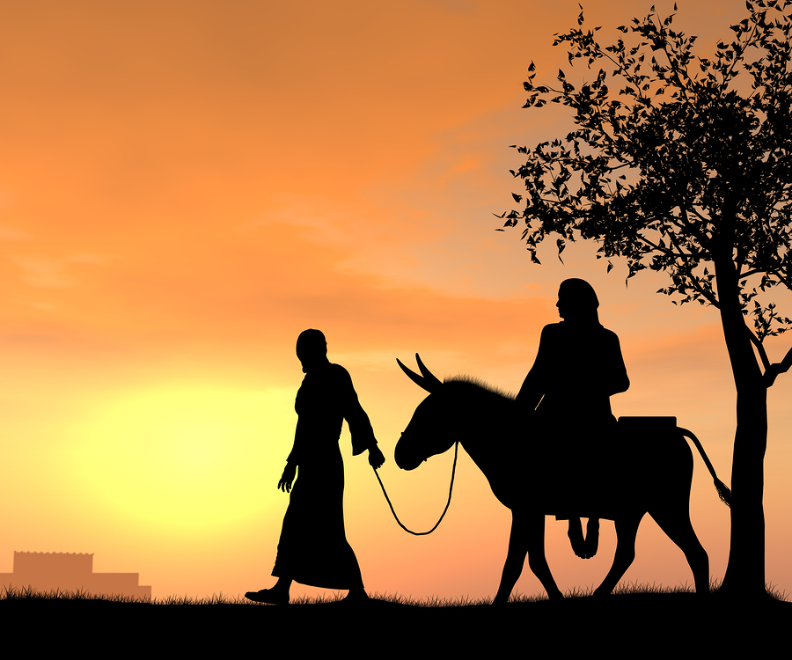
MARY DID YOU KNOW?

Slide 3
WHAT DID MARY KNOW?
BEFORE THE BIRTH OF CHRIST
Specially blessed
AFTER THE BIRTH OF CHRIST
Salvation to all
AT THE CROSS OF CHRIST
Son of God

