Slide 2
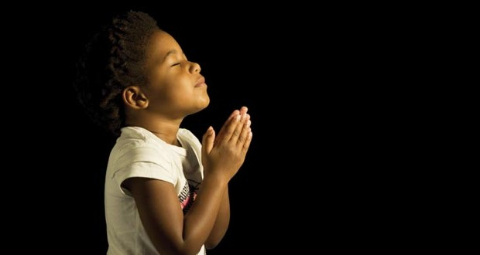
“Now I lay me down to sleep, I pray Thee, Lord, my soul to keep, if I should die before I wake, I pray Thee, Lord, my soul to take.”

Slide 3
“Now I lay me down to sleep, I pray Thee, Lord, my soul to keep, if I should die before I wake, I pray Thee, Lord, my soul to take.”

Slide 4
COME BEFORE WINTER
I AM SORRY
I FORGIVE YOU
I LOVE YOU

