Slide 2
WWJD

Slide 3
WWJND
What Would Jesus Not Do?

Slide 4
Jehovah Witnesses:
"Michael the Archangel is no other than the only begotten Son of God, now Jesus Christ."
Mormons:
Claim to believe in the Jesus revealed in scripture
Additionally they believe that Jesus, the devil, and the Holy Ghost are brothers born to God the Father by one of his wives in Heaven before the world was created
Jesus was married and had children
Islam:
"Jesus was no more than a mortal whom Allah favored and made an example to the Israelites. They are unbelievers who say God is Messiah, Mary's son."

Slide 6
Unique
King
God

Slide 7
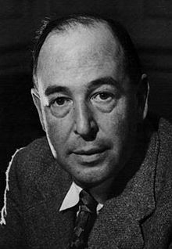
“A man who was merely a man and said the sort of things Jesus said would not be a great moral teacher. He would either be a lunatic - on the level with a man who says he is a poached egg - or he would be the devil of hell. You must take your choice. Either this was, and is, the Son of God, or else a madman or something worse. You can shut Him up for a fool or you can fall at His feet and call Him Lord and God. But let us not come with any patronizing nonsense about His being a great human teacher. He has not left that open to us.”

